Slide 1
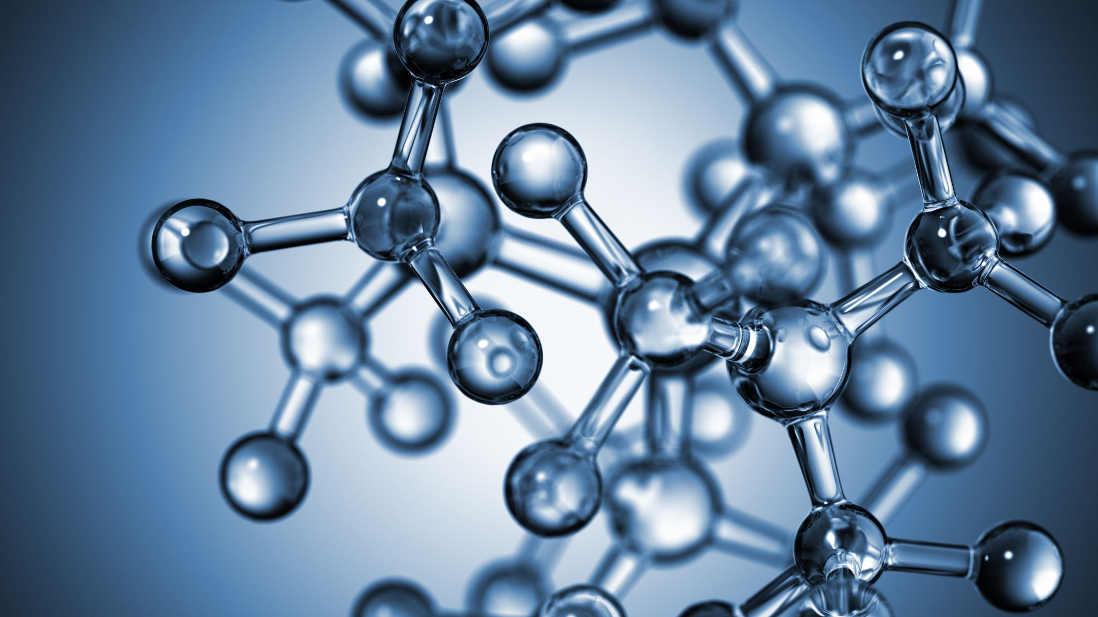


Kinetics of chemical reactions
Al-Farabi Kazakh National University
Faculty of Chemistry and Chemical technology
Department of General and Inorganic Chemistry
pHd Bakhadur askar

Slide 2
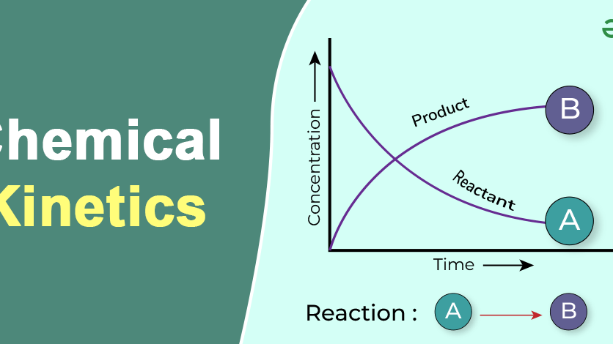
Chemical kinetics
Chemical kinetics is the study of the speed at which chemical reactions occur and the mechanisms by which they proceed.
While thermodynamics tells us whether a reaction is possible, kinetics explains how fast it will occur and through what pathway.
Understanding kinetics is essential for controlling industrial processes, designing catalysts, and studying biochemical systems.

Slide 3
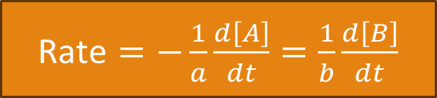
Reaction rate
The rate of a chemical reaction is the change in concentration of a reactant or product per unit time:
where a and b are stoichiometric coefficients.
Rates can be measured experimentally by monitoring pressure, color, conductivity, or concentration changes.
$\text{Rate}=−\frac{1}{a}\frac{d\left[A\right]}{dt}=\frac{1}{b}\frac{d\left[B\right]}{dt}$

Slide 4

Rate law and rate constant
The rate law expresses how the rate depends on reactant concentrations:
k = rate constant
m, n = reaction orders (determined experimentally)
The overall order of the reaction is m + n.
Rate laws provide insight into the mechanism rather than just the stoichiometry.
$$\text{Rate}=k\left[A{\left.]\right.}^{m}\left[B{\left.]\right.}^{n}\right.\right.$$

Slide 5

Factors affecting reaction rate
Concentration – higher concentration increases collision frequency.
Temperature – usually increases rate; described by the Arrhenius equation:
Catalysts – lower activation energy, providing an alternative pathway.
Surface area – affects heterogeneous reactions.
Nature of reactants – bond strength and phase matter.
$$k=Ae^{−E_{a}/RT}$$

Slide 6
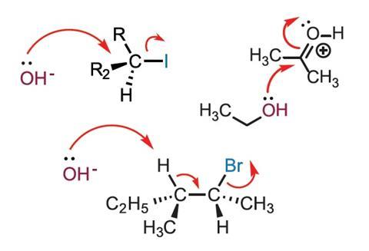
Reaction mechanisms
A mechanism is a sequence of elementary steps that describe the overall process.
Each step has its own rate law, and the slowest one is the rate-determining step (RDS).
Experimental rate laws help confirm or refute proposed mechanisms.
Intermediates appear in the mechanism but not in the overall balanced equation.

Slide 7
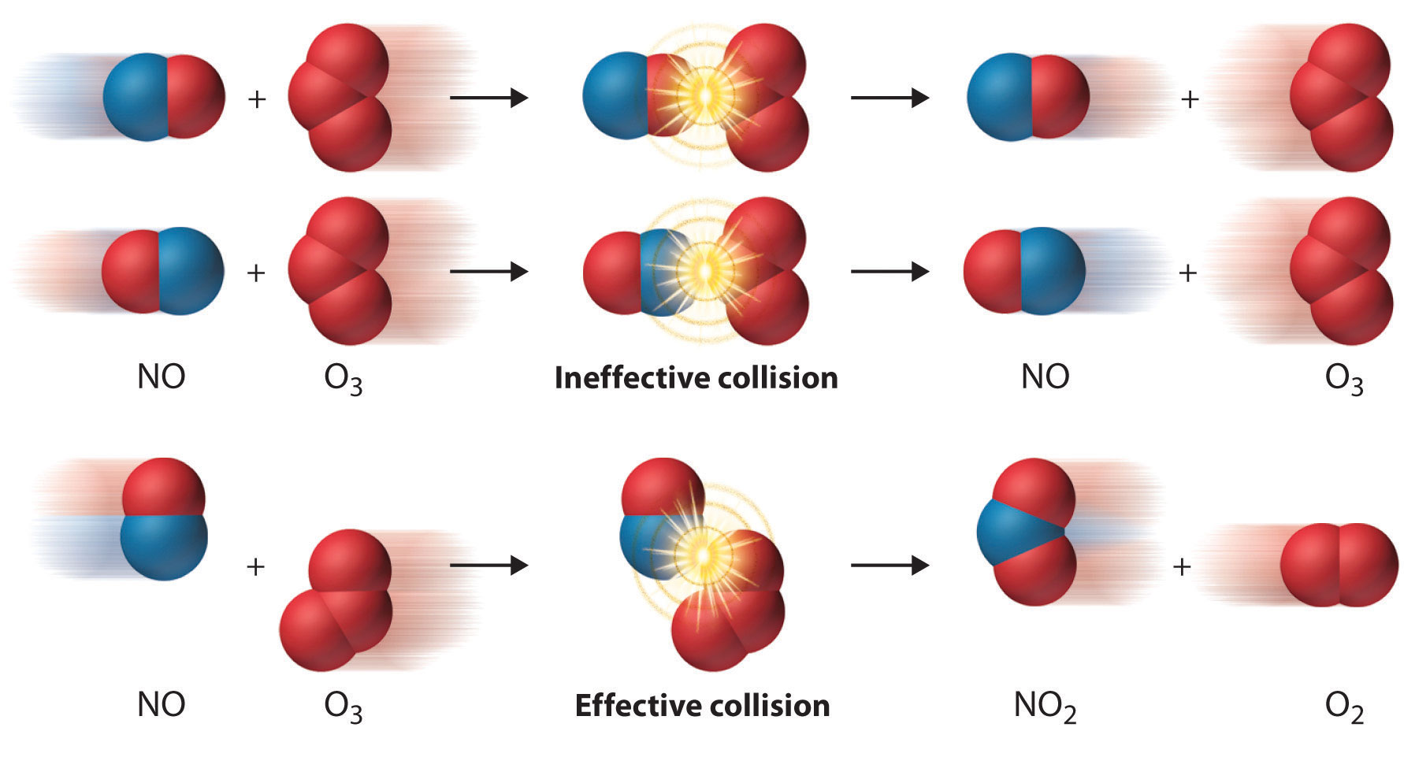
Theories of reaction rates
Collision theory
Reactions occur when molecules collide with sufficient energy and correct orientation.

Slide 8
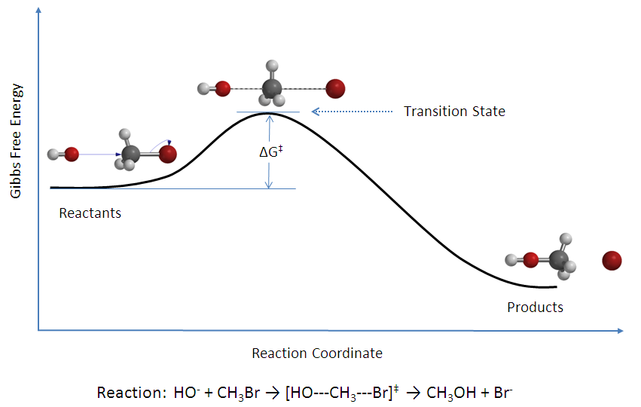
Theories of reaction rates
Transition state theory
Reactants form an activated complex at the energy peak before transforming into products.

Slide 9
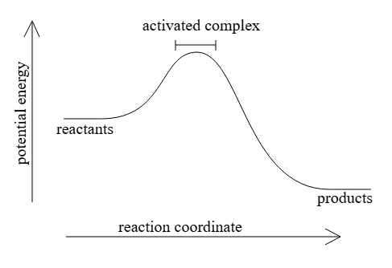
Theories of reaction rates
Activated complex energy profile
Shows energy change from reactants → activated complex → products.

Slide 10
Applications
Industrial chemistry: optimizing conditions for maximum yield.
Environmental science: understanding pollutant degradation rates.
Biochemistry: enzyme kinetics and metabolic control.
Chemical kinetics bridges theory and practice by explaining how, why, and how fast reactions occur.
Mastery of kinetics enables control of chemical processes in laboratories, industries, and living systems.

Slide 11

Questions?

